Slide 1
PROJECT TITLE
CAPSTONE PROJECT
Presented By:SHAILESH KUMAR MUDA
Student Name : SHAILESH MUDA
College Name & Department : GURUNANAK INSTITUTIONS TECHNICAL CAMPUS & CYBER SECURITY(CSE)

Slide 2
OUTLINE
Problem Statement
Technology used
Wow factor
End users
Result
Conclusion
Git-hub Link
Future scope

Slide 3
Problem Statement
Concealing the Existence of a Message: This is the basic problem statement in steganography, where the task is to hide a message in another piece of information (e.g., an image, audio file, etc.) without leaving any visible signs that the message is there.

Slide 4
Technology used
Steganography uses a variety of technologies, including:
Least significant bit (LSB) insertion: A common technique that replaces the least significant bits of a cover image with secret data
Pixel value difference (PVD) based steganography: A technique that addresses message size and stego-image quality
Random bit-plane selection: A technique that uses artificial intelligence to hide information in images
Edge-based image steganography: A technique that hides text in a digital image file or uses it as an encryption key
Exploiting modification direction (EMD): A technique that protects the fidelity of stego-images
Matrix encoding: A technique used to embed secret data
Encryption: A technique that can be used in combination with steganography to further protect information
Some examples of steganography software include:
OpenStego, an open-source software that supports multiple carrier file formats
Steghide, NoClue, OpenPuff, snow

Slide 5
Wow factors
- It includes a whole host of techniques, and one which standards out is steganography which comes from steganos, or covered.
- What makes steganography unique is that it is a technique of making information hard to find, not hard to read once found.
- Whereas cryptography is the practice of protecting the contents of a message alone, steganography is concerned with concealing both the fact that a secret message is being sent and its contents.
- Steganography includes the concealment of information within computer files.

Slide 6
End users
The end users in steganography are typically individuals or organizations who use the technique to hide data in other files, primarily to protect sensitive information or to maintain privacy. These users can come from various sectors, including:
- Education and Business Instituitons
- Military
- Individuals seeking privacy
- Cryptographers
- Certified Ethical Hackers
- Script Kiddies

Slide 7

Results
ENCRYPTED IMAGE USED IN CODE

Slide 8
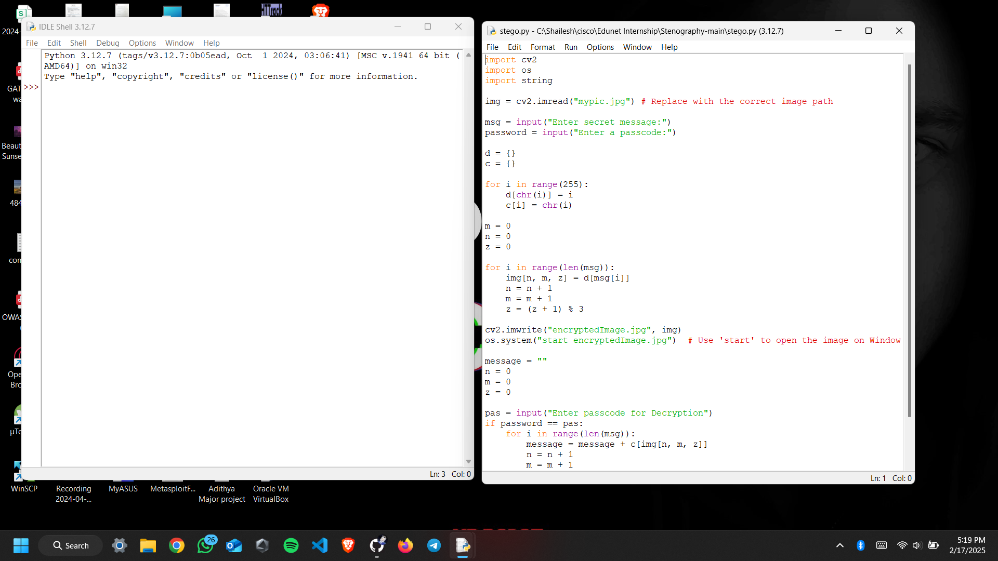
Screenshots : encrypting using cover file and secret key

Slide 9
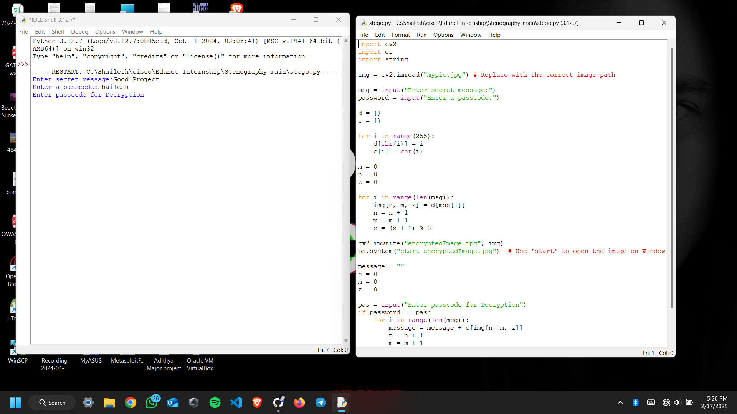
creating stegno object

Slide 10
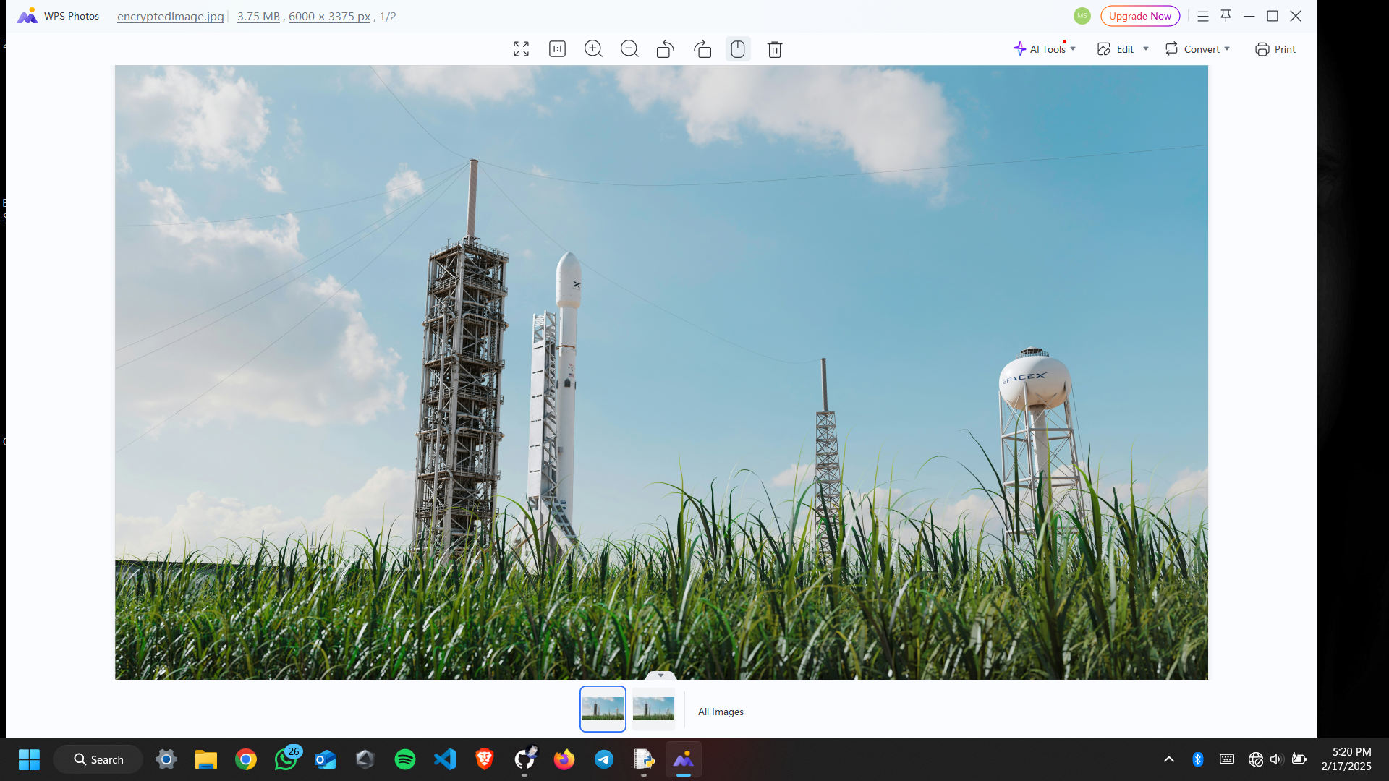
encrypted image(stegno object)

Slide 11

After decryption (viewing text after using key)

Slide 12
conclusion:
In this project, we explored the principles, methods, and applications of steganography, focusing on its ability to securely hide data within other files like images, audio, and video. Through the development and implementation of various steganographic algorithms, we demonstrated how data can be concealed in a manner that is nearly undetectable to the human eye or ear, but recoverable by authorized users using appropriate decryption methods.
Key findings from this project include:
The importance of selecting the right steganographic method based on the type of data being concealed and the desired level of security.
The significance of embedding data in such a way that it does not significantly alter the host file, thereby reducing the risk of detection.
Overall, steganography remains a vital tool in fields such as cybersecurity, privacy protection, and covert communications. However, the ethical considerations and potential for misuse highlight the need for regulation and responsible use.

Slide 13
GitHub Link
https://github.com/CanYaman6/Steganography.git

Slide 14
Future scope(optional)
Steganography, the practice of concealing messages or information within other non-suspicious data (like images, audio, or video files), is an evolving field with considerable future potential. Here are some key areas where steganography could have significant developments:
Protection against Data Breaches
Securing Communication
Hidden BlockChain Messages and Smart Contracts
Embedded data in sensor Networks
CyberSecurity and Data Privacy

Slide 15
THANK YOU

